Slide 1
Disclaimer
OneSource for Longevity Readiness Inc is recognized by the IRS as a 501(c) 3 non-profit organization that provides educational workshops and coaching. Our coaches and community educators are trained professionals and must have a minimum of 5 years of real-world experience in their field. They have been required to pass a series of training sessions on how to properly educate in a non-profit setting. The workshops do not promote or endorse any specific products, companies and no selling is allowed. The workshops are for general education only and are not intended to be construed as Investment, Tax, Legal, Medical or Financial Advice. Attendees should seek the assistance of a professionals prior to implementing any of the ideas or strategies discussed at the workshop.
Notes:
“Before we get started… here’s a quick house keeping item the lawyers want us to read.”
(Keep it light and tongue in cheek… like, “those darn lawyers!”)
Then read the slide word for word.

Slide 2
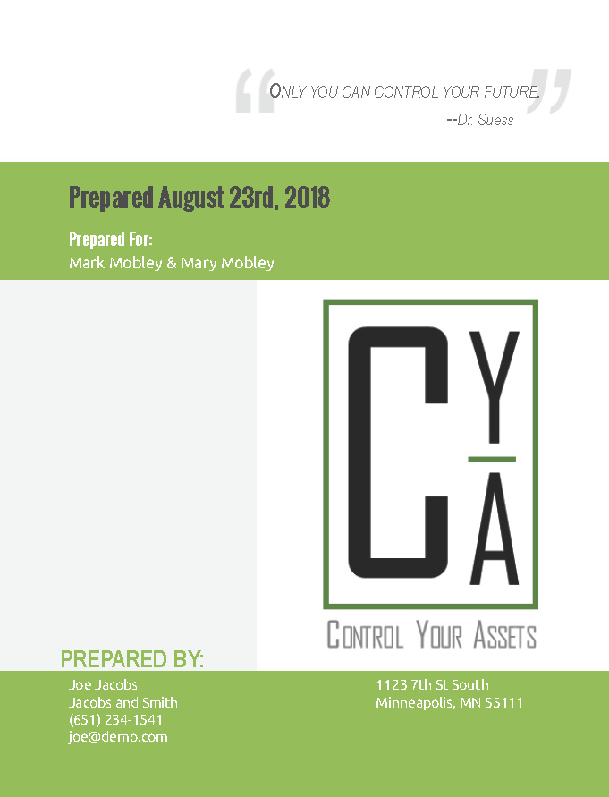

Slide 3
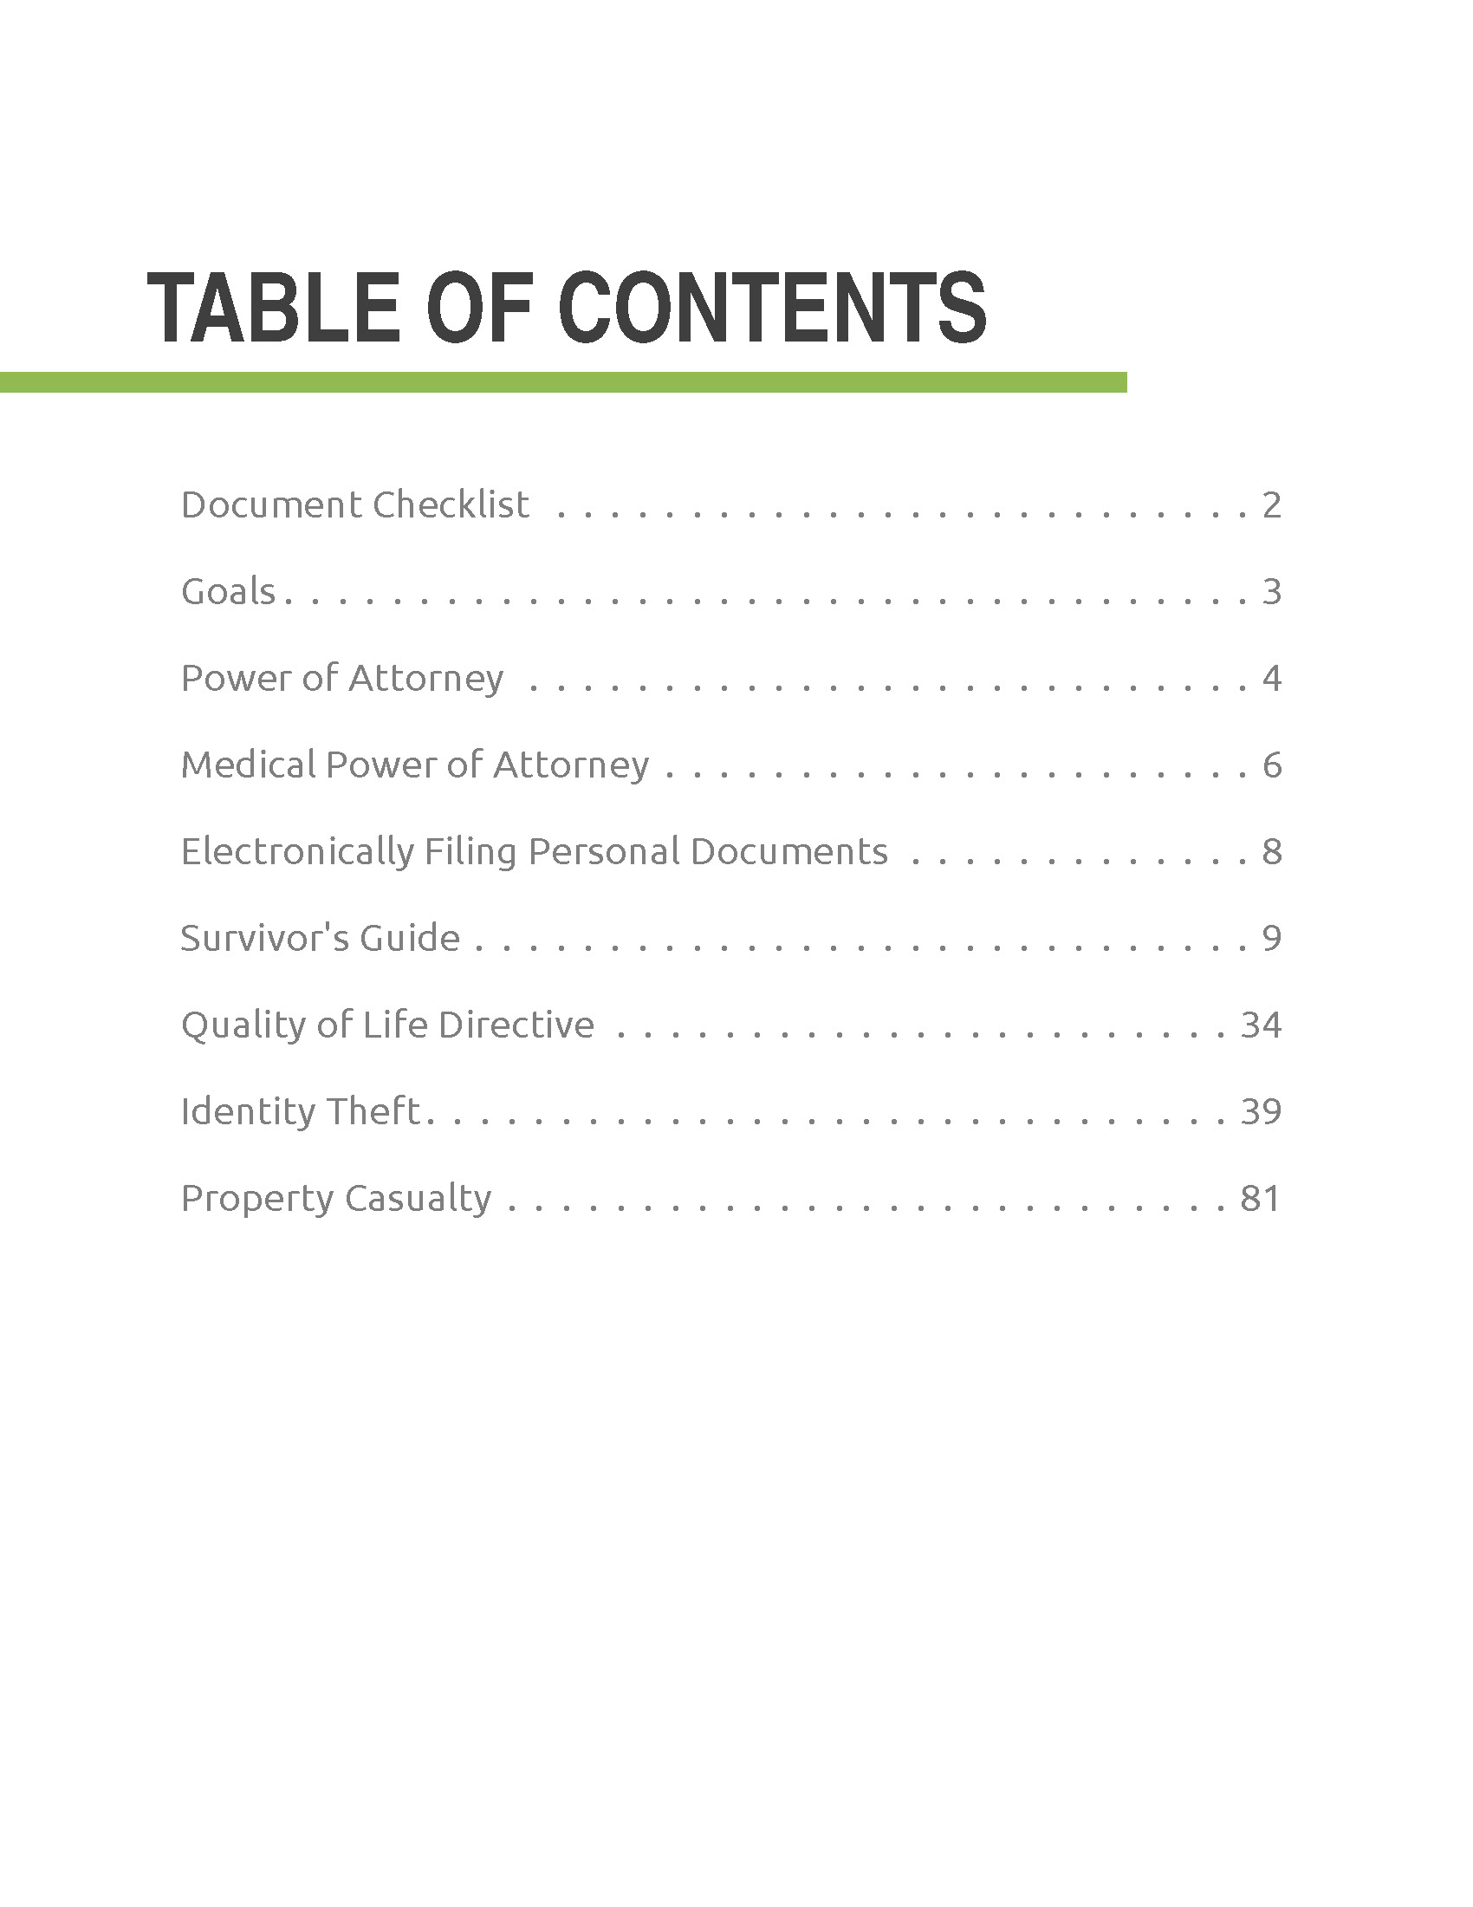

Slide 5
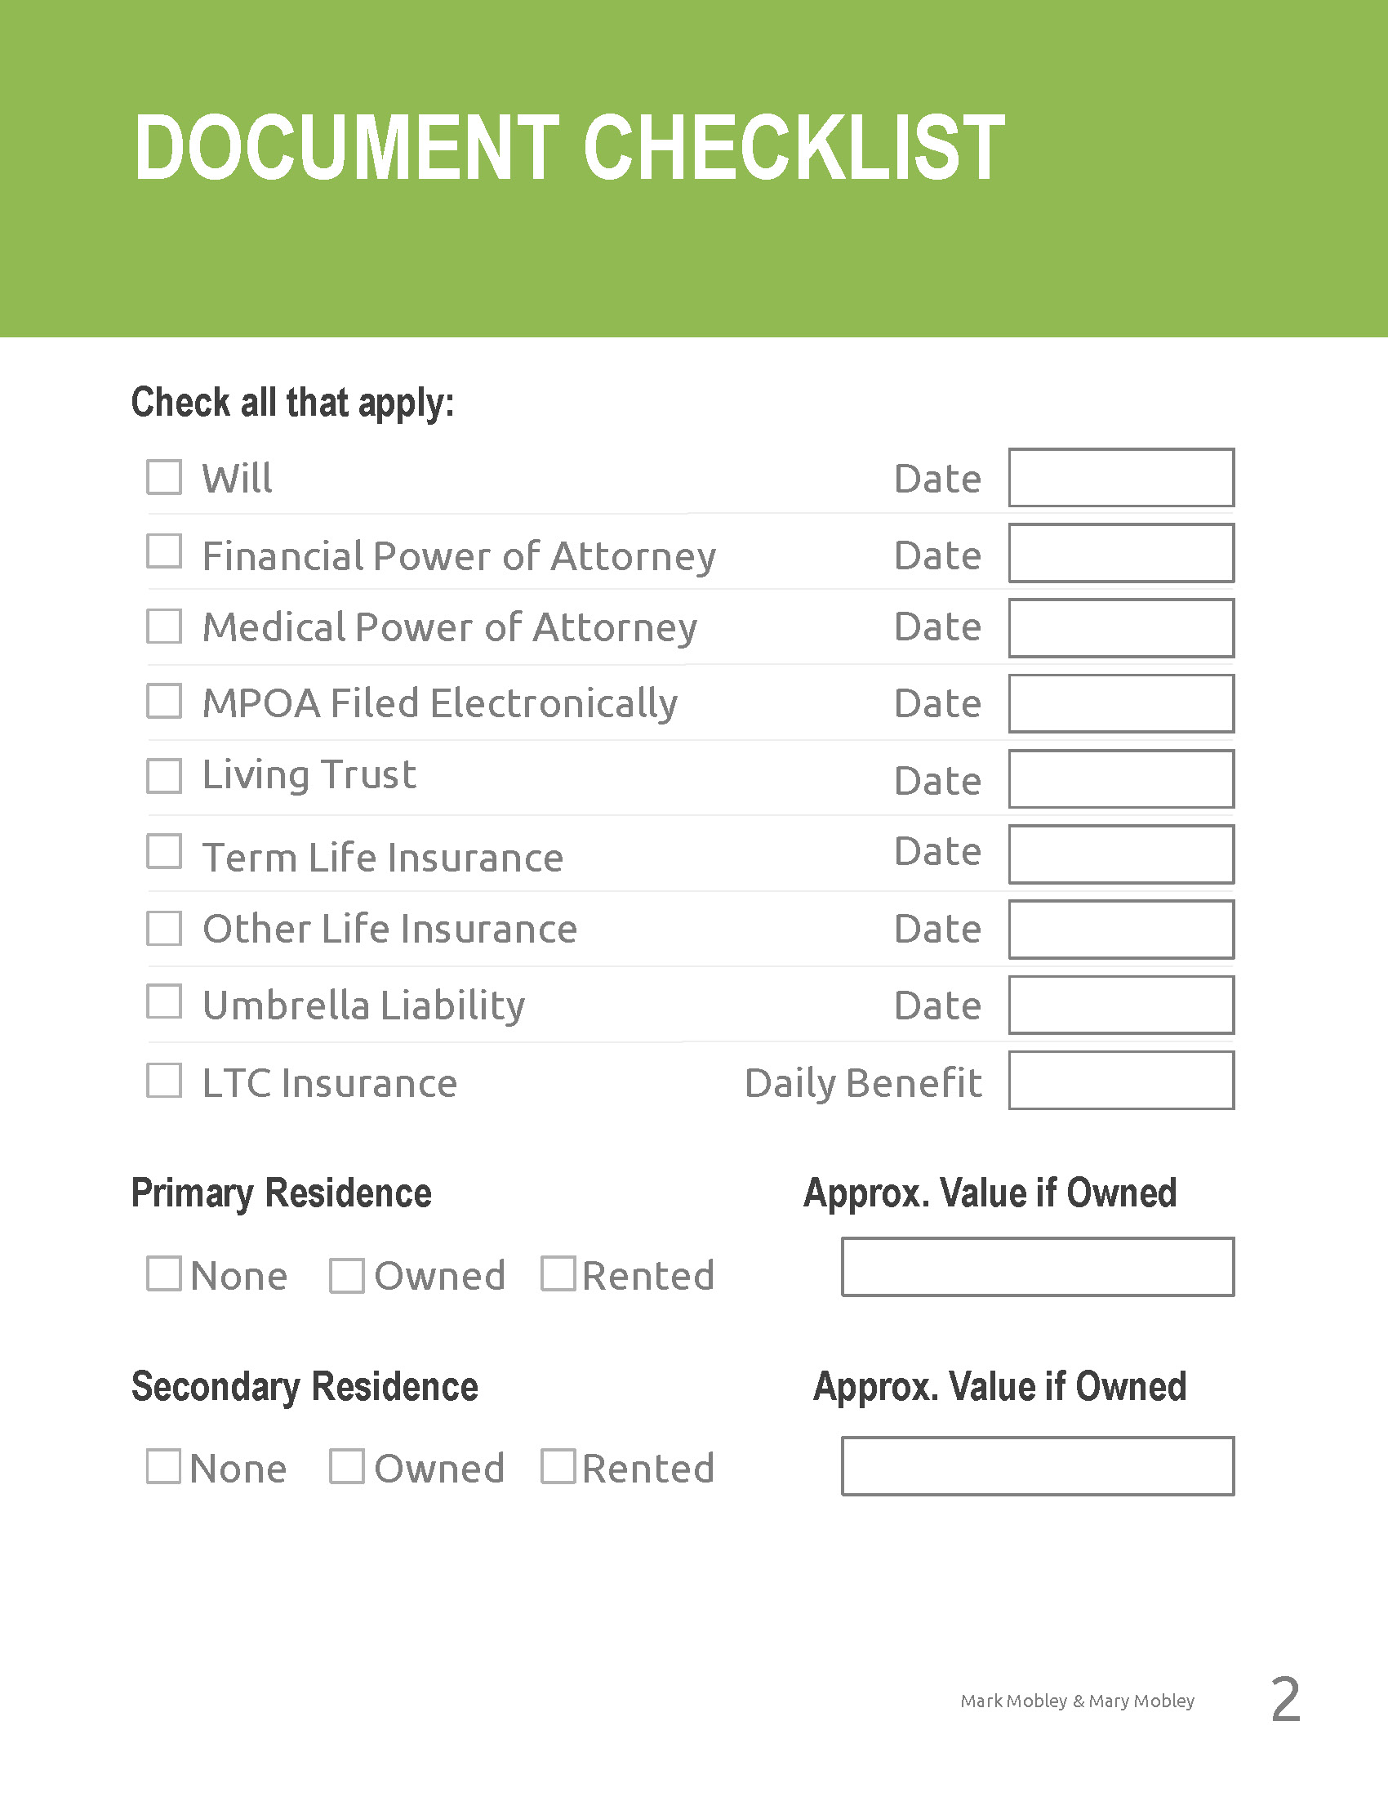

Slide 7
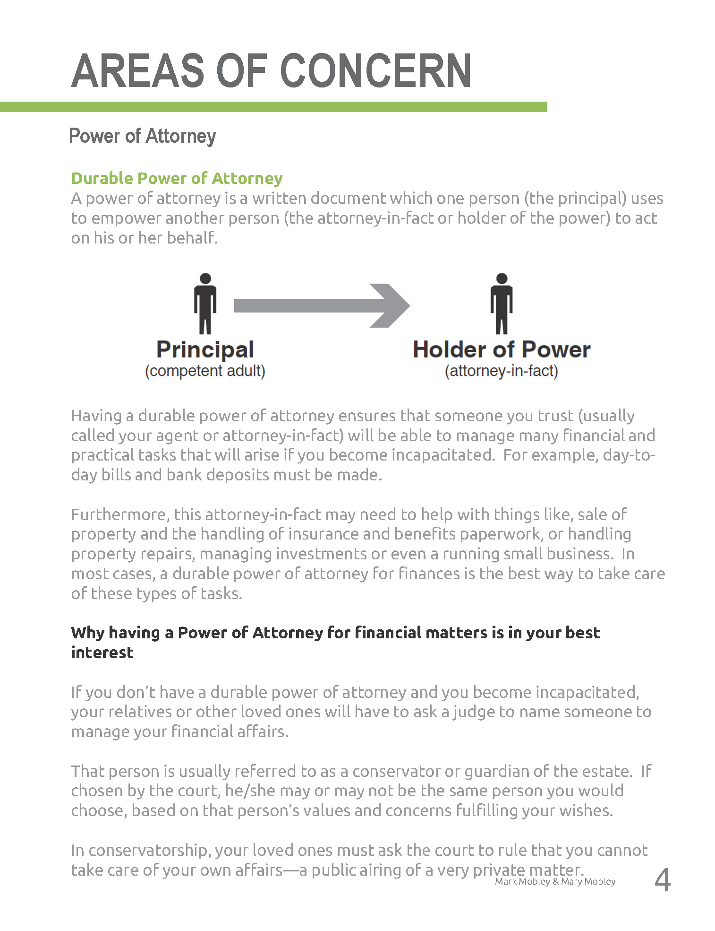

Slide 8
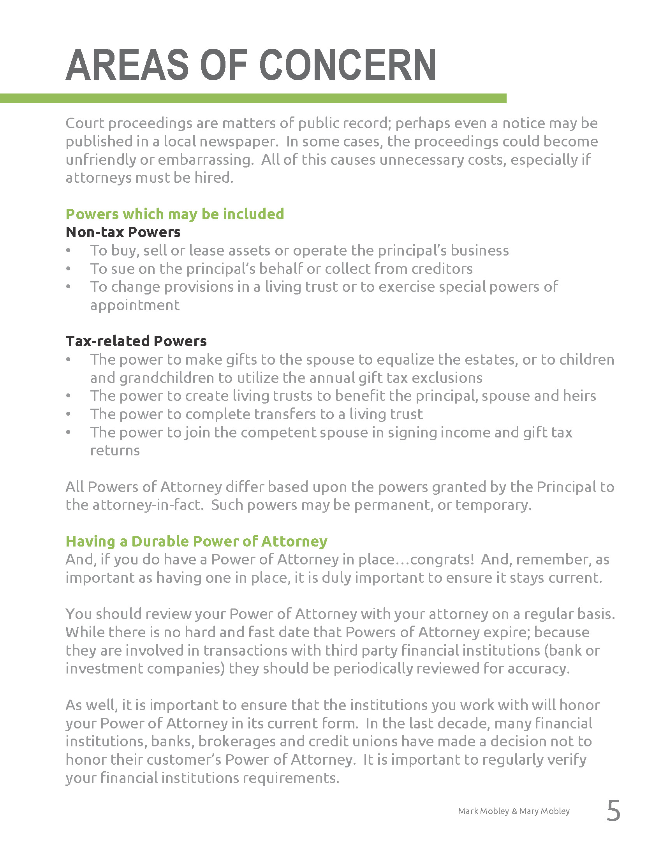

Slide 9
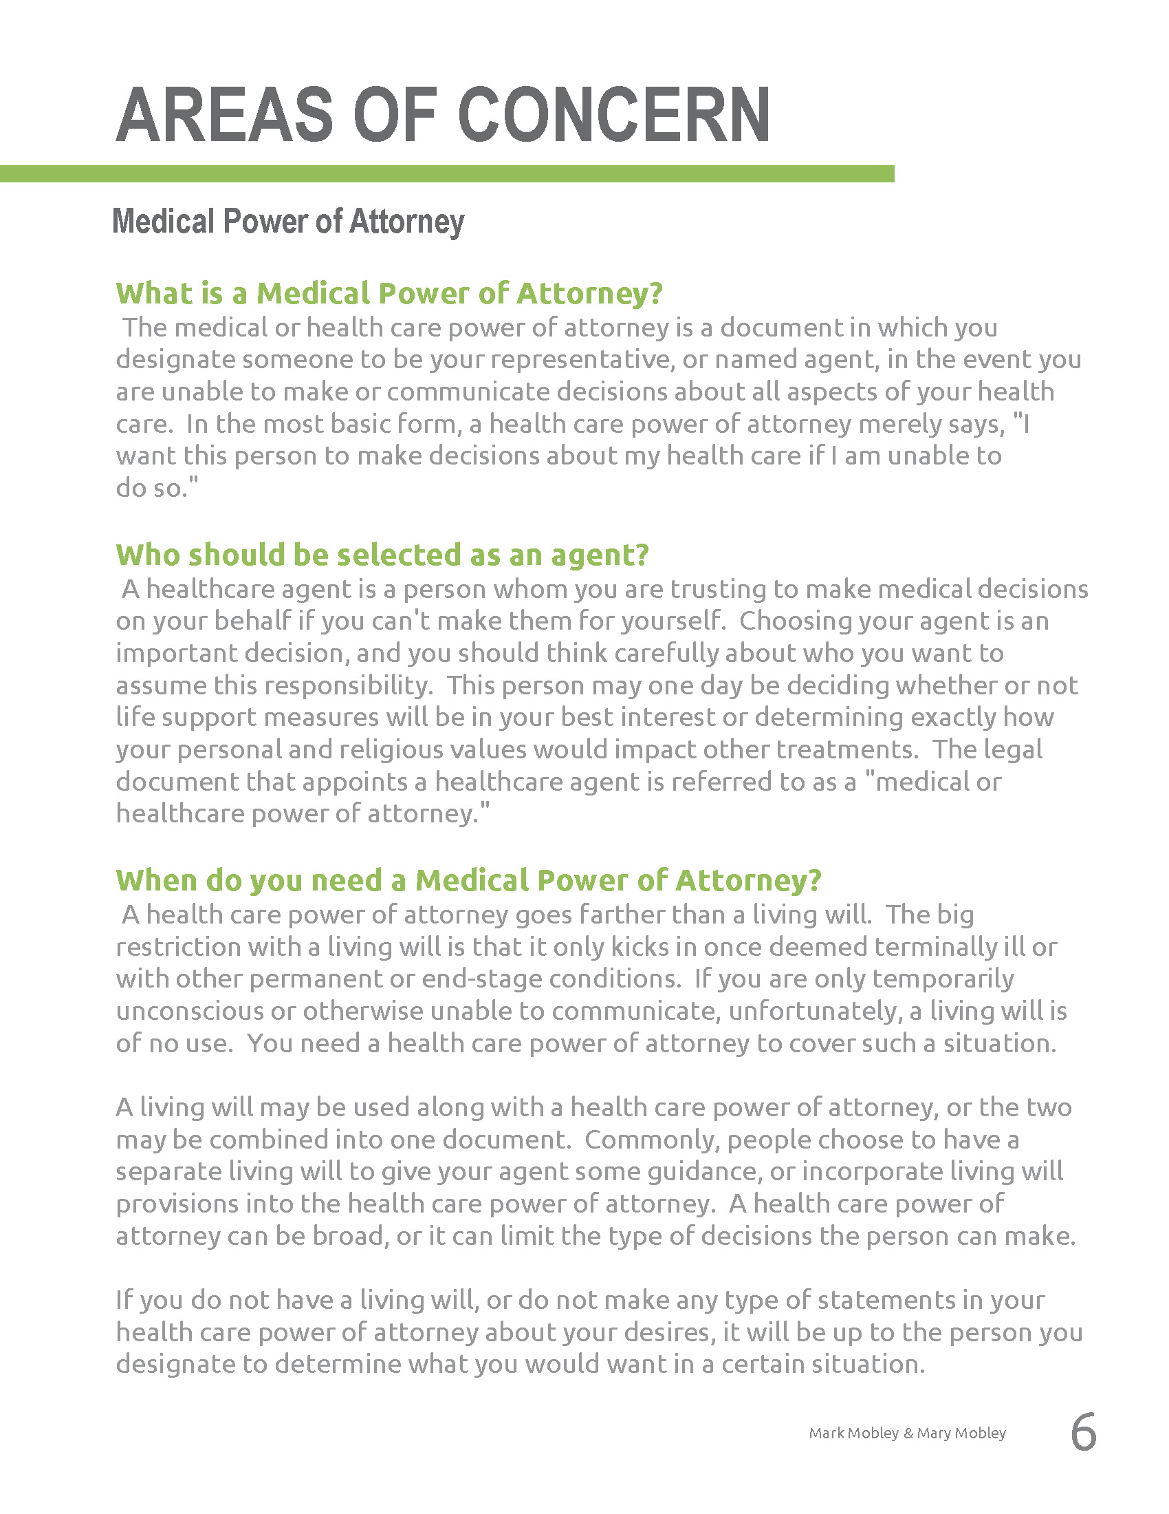

Slide 10
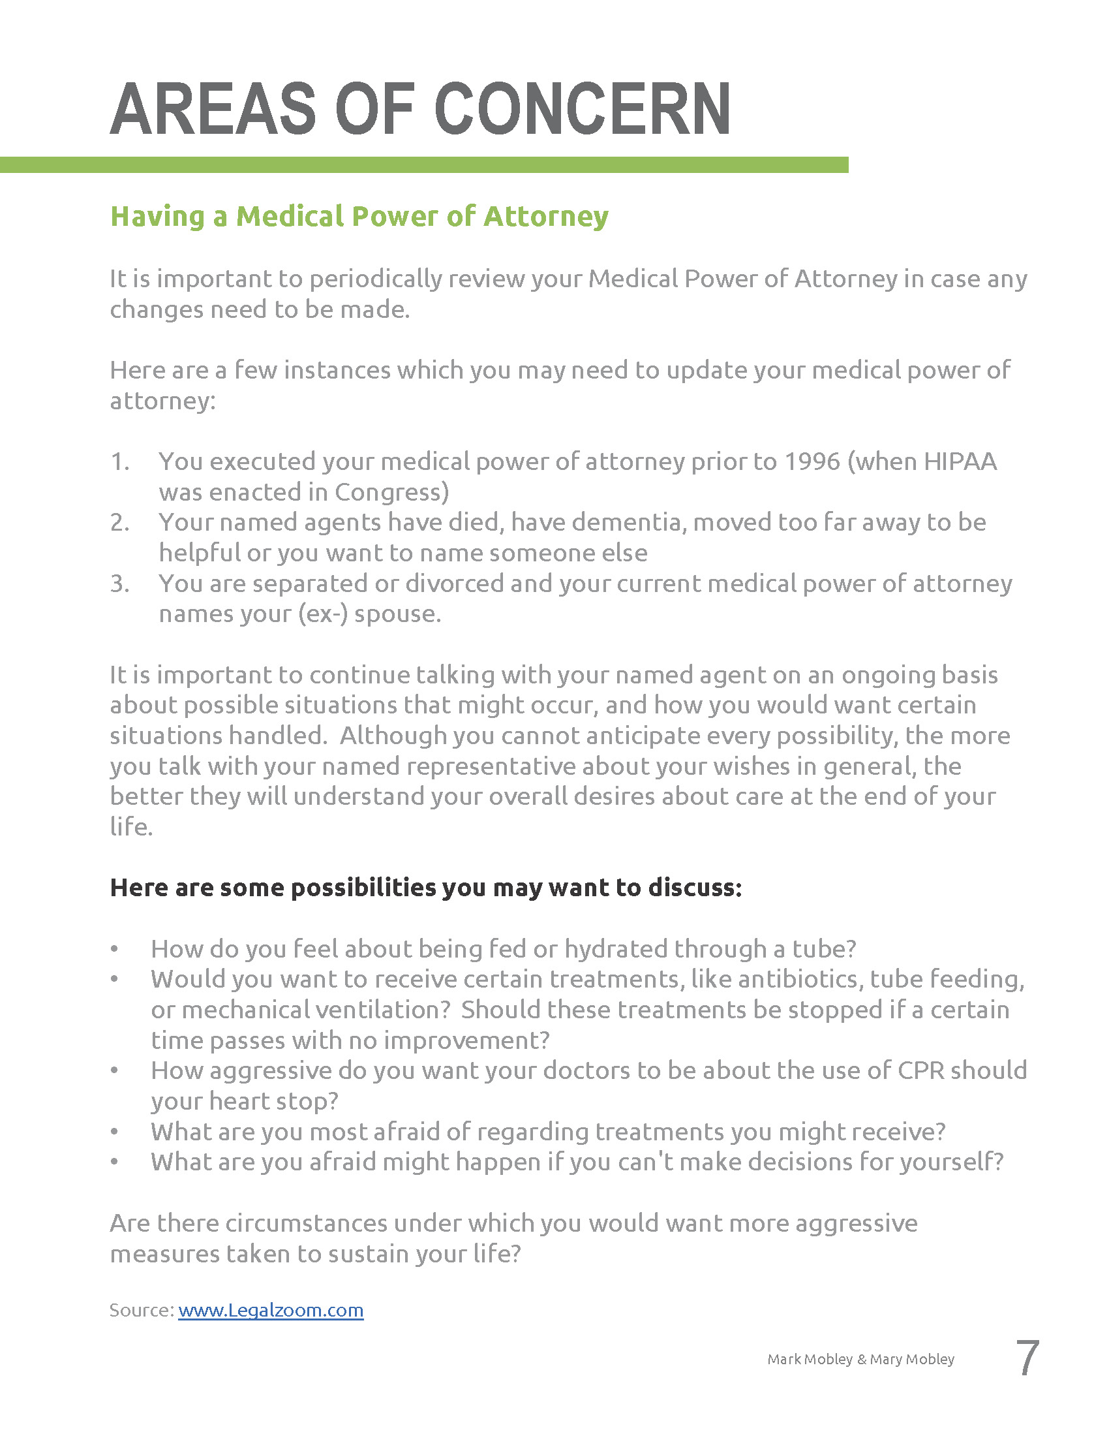

Slide 13
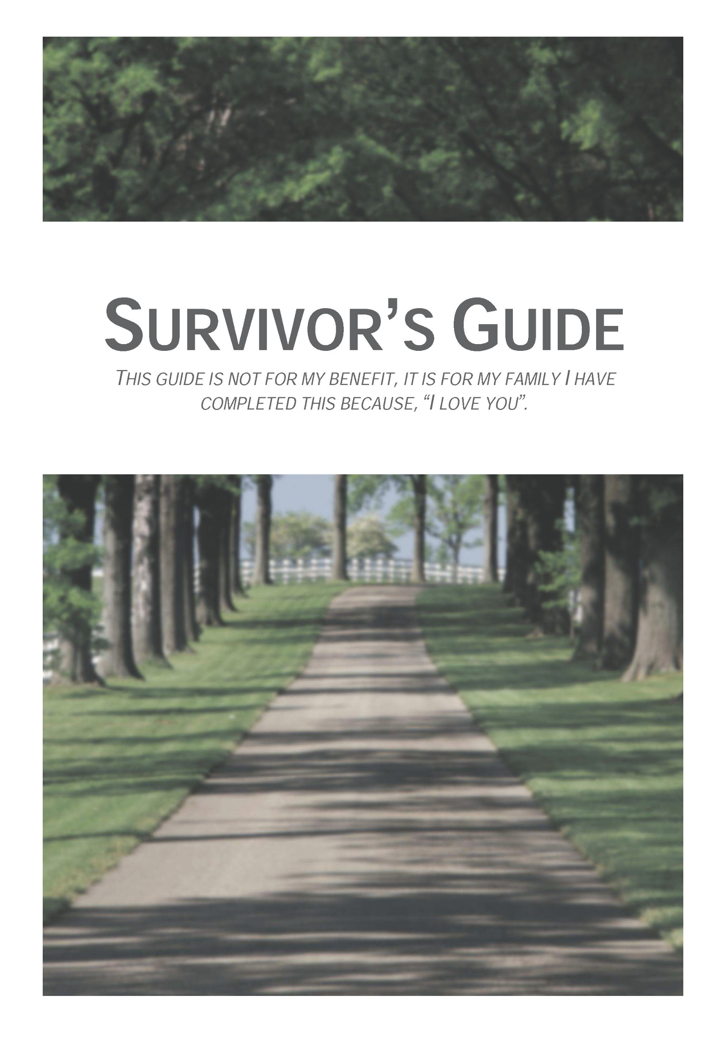

Slide 14
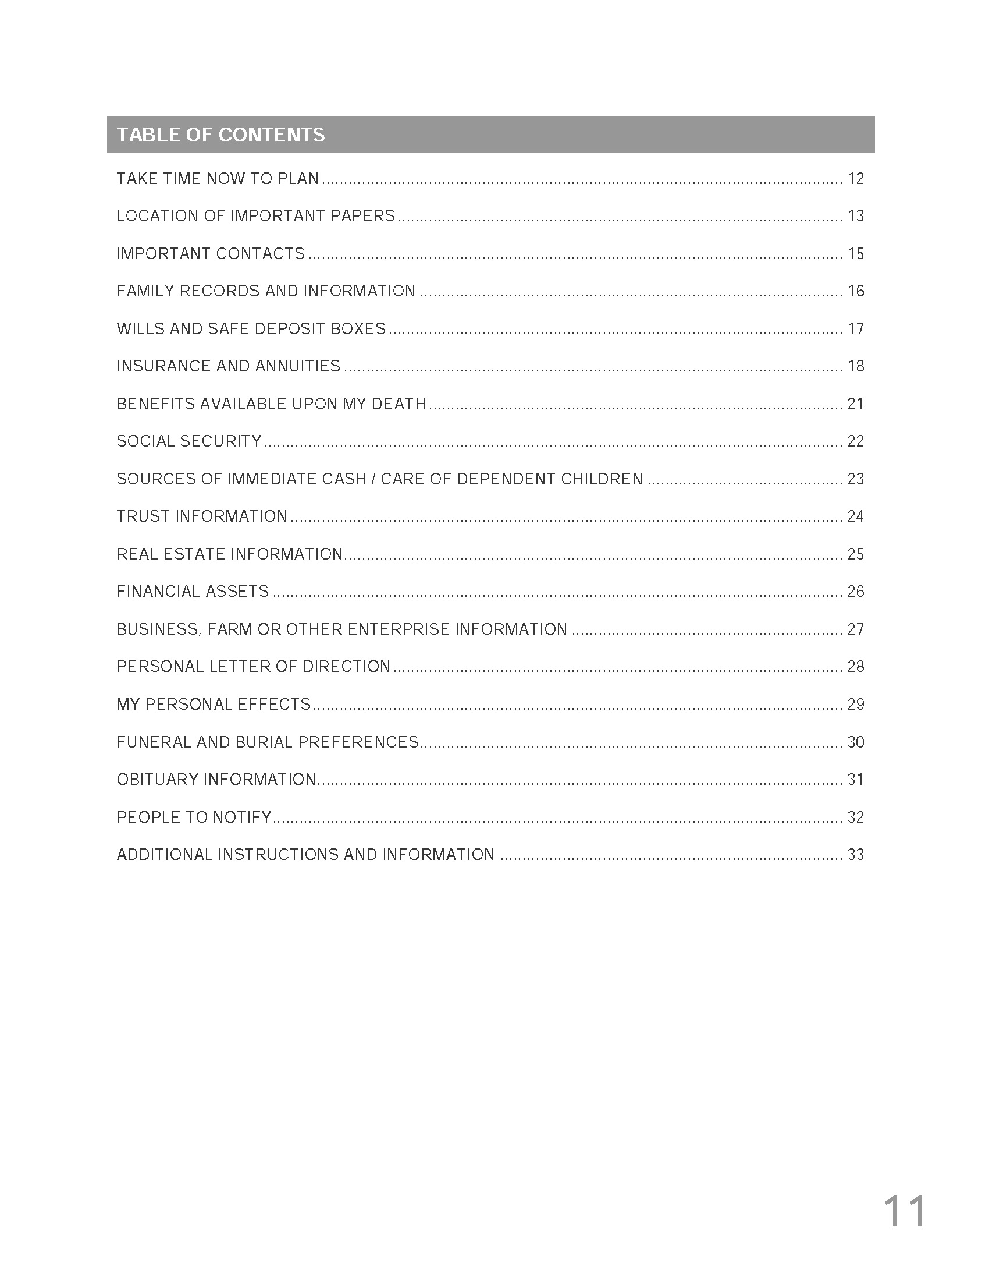

Slide 15
Some of the Topics Covered within the Survivors Guide are…

Slide 16
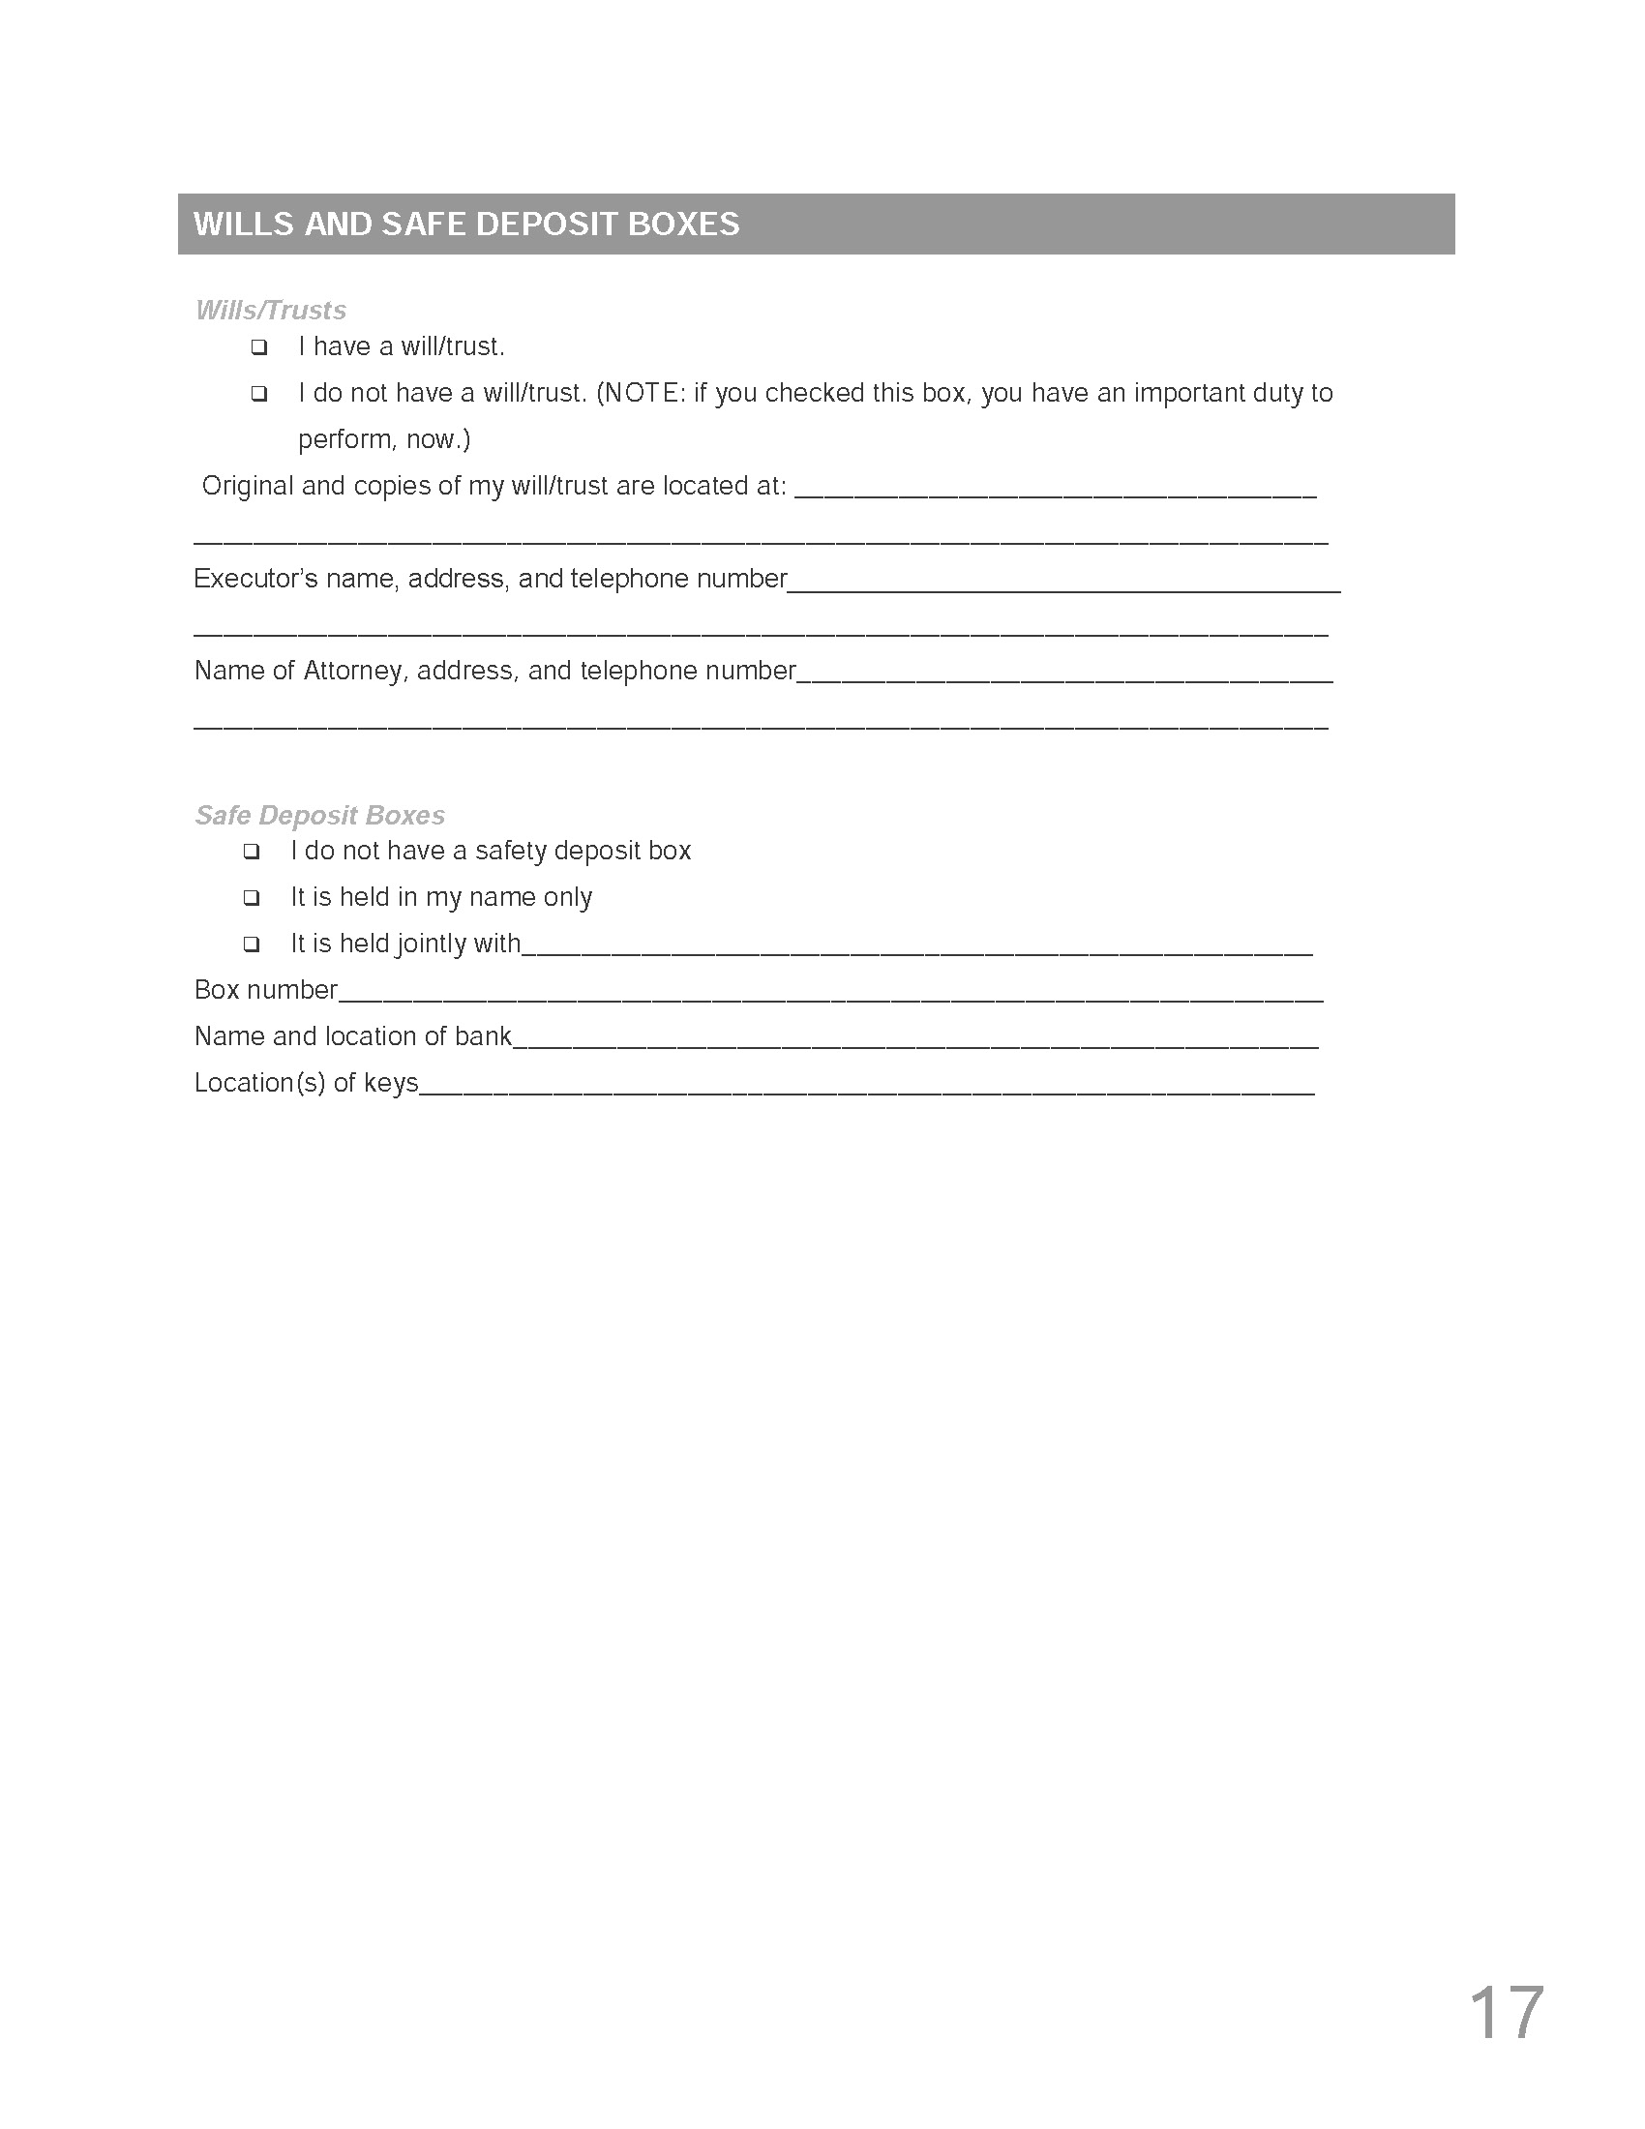

Slide 17
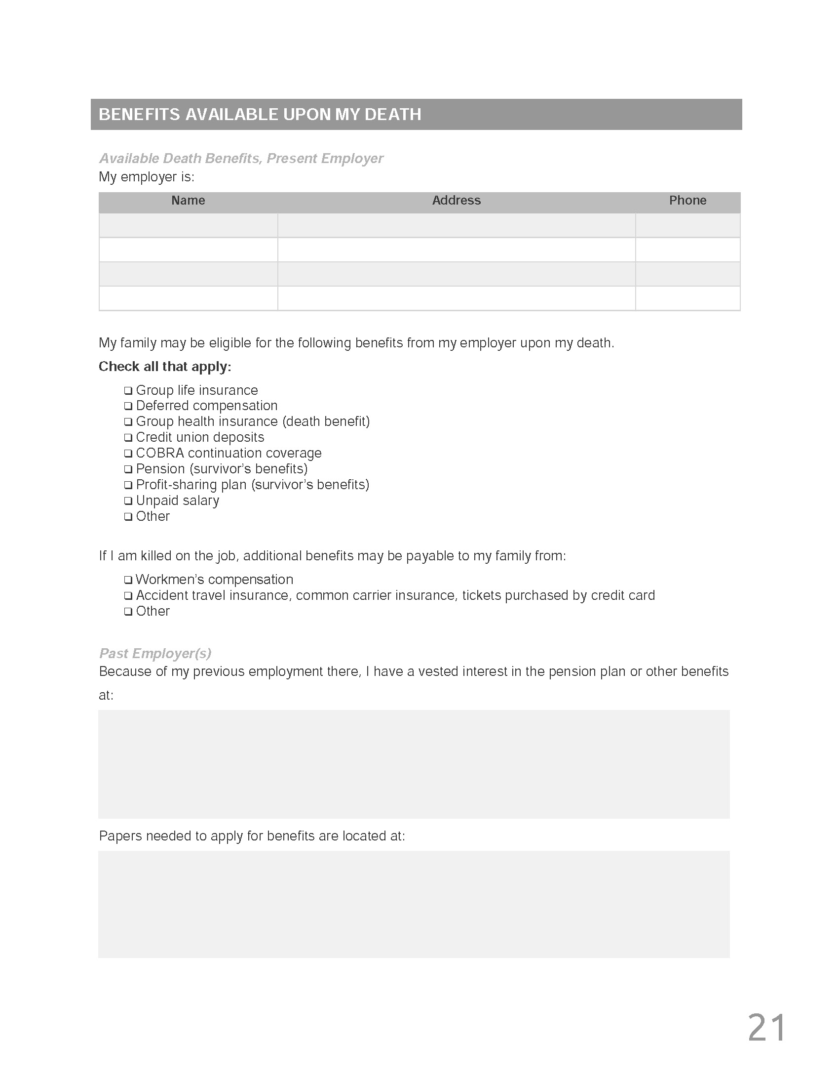

Slide 18
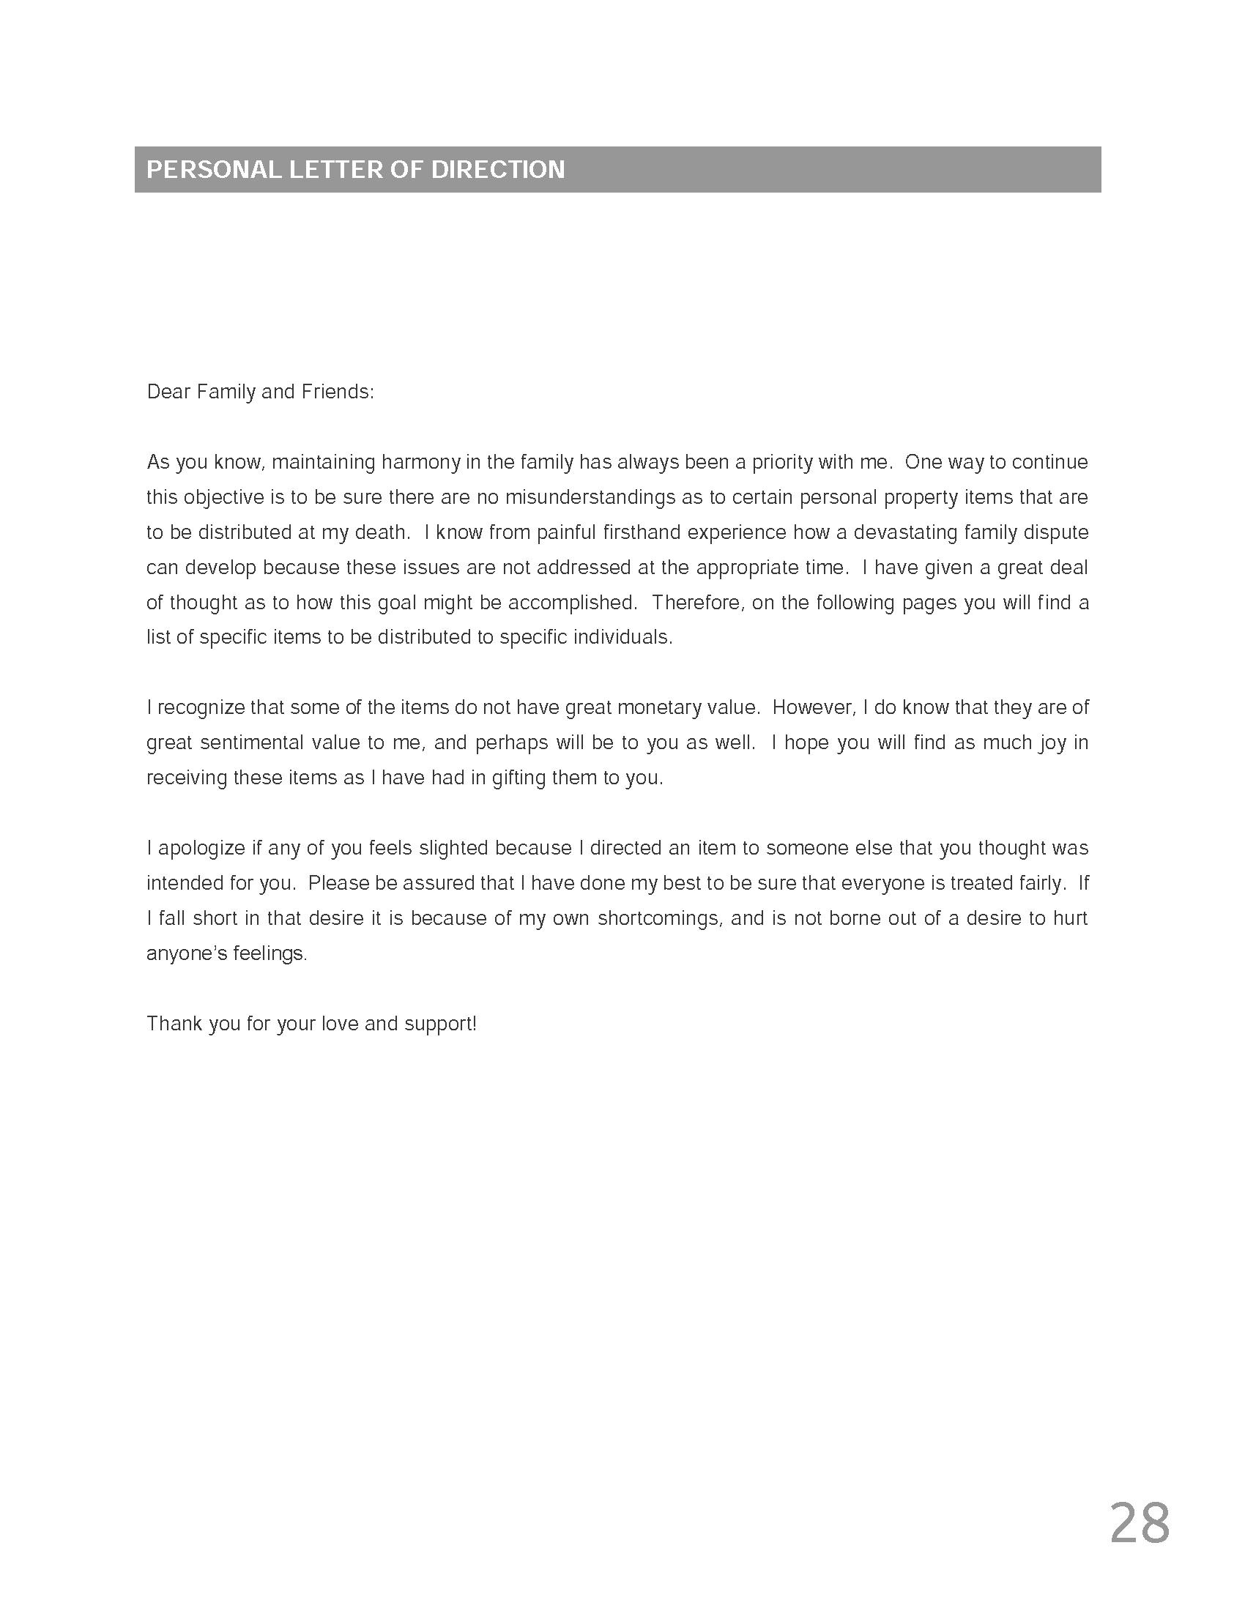

Slide 19
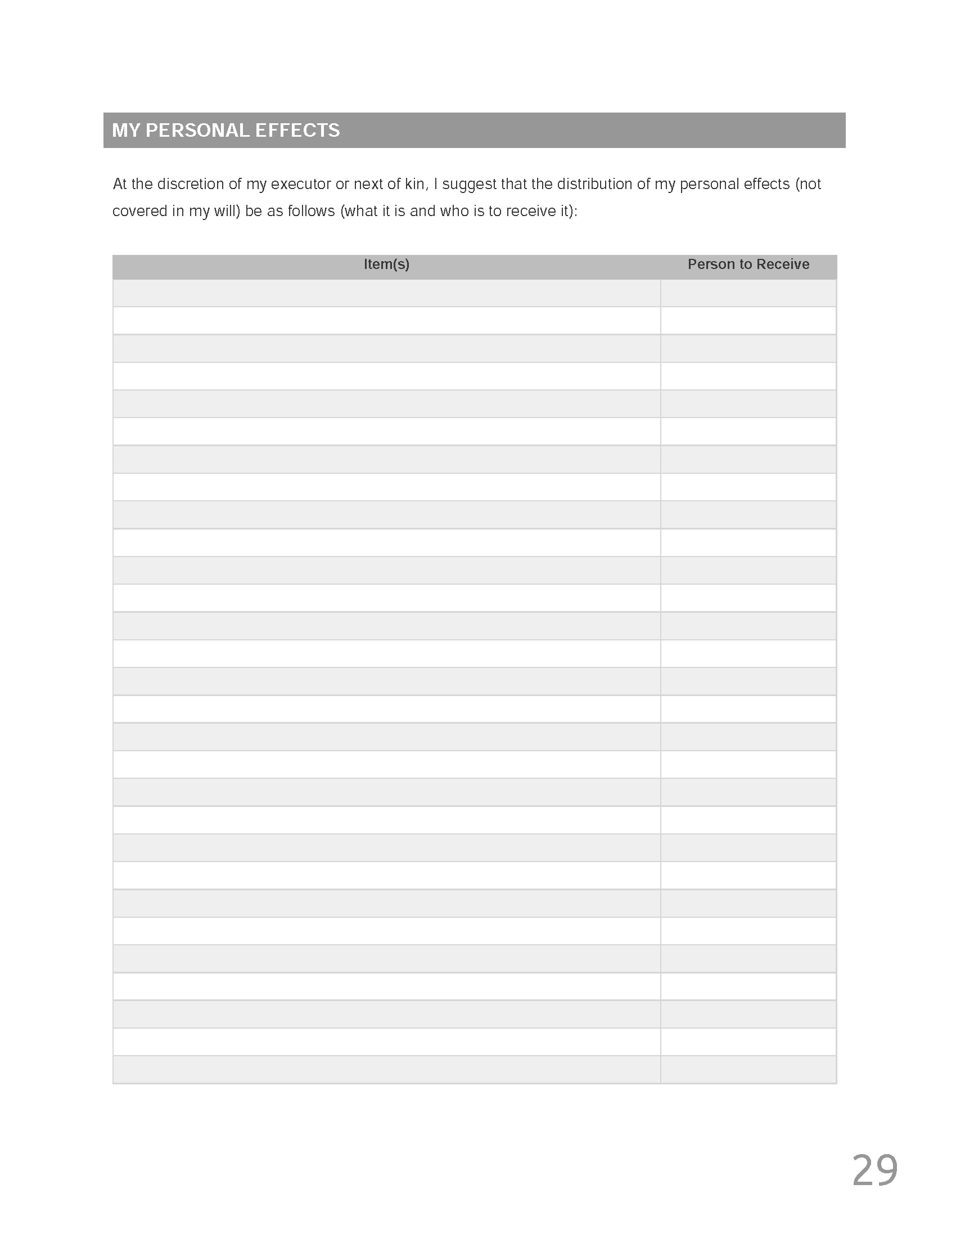

Slide 20
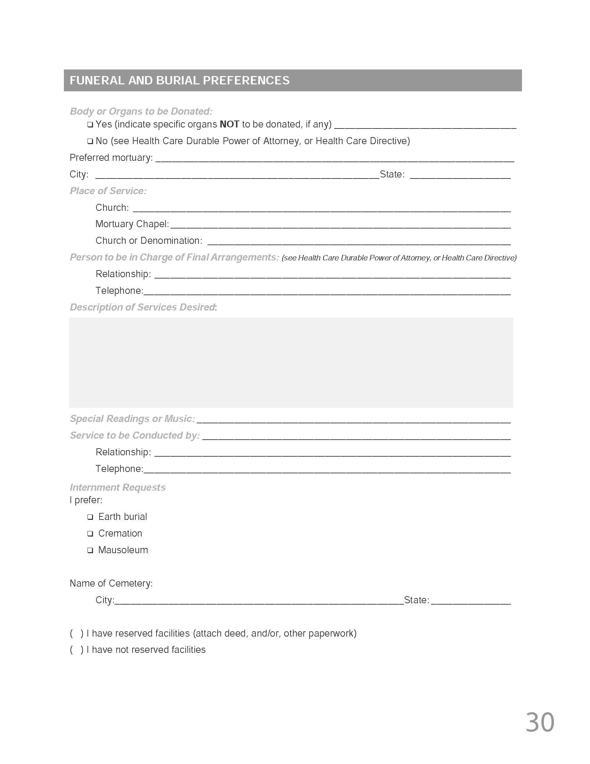

Slide 21
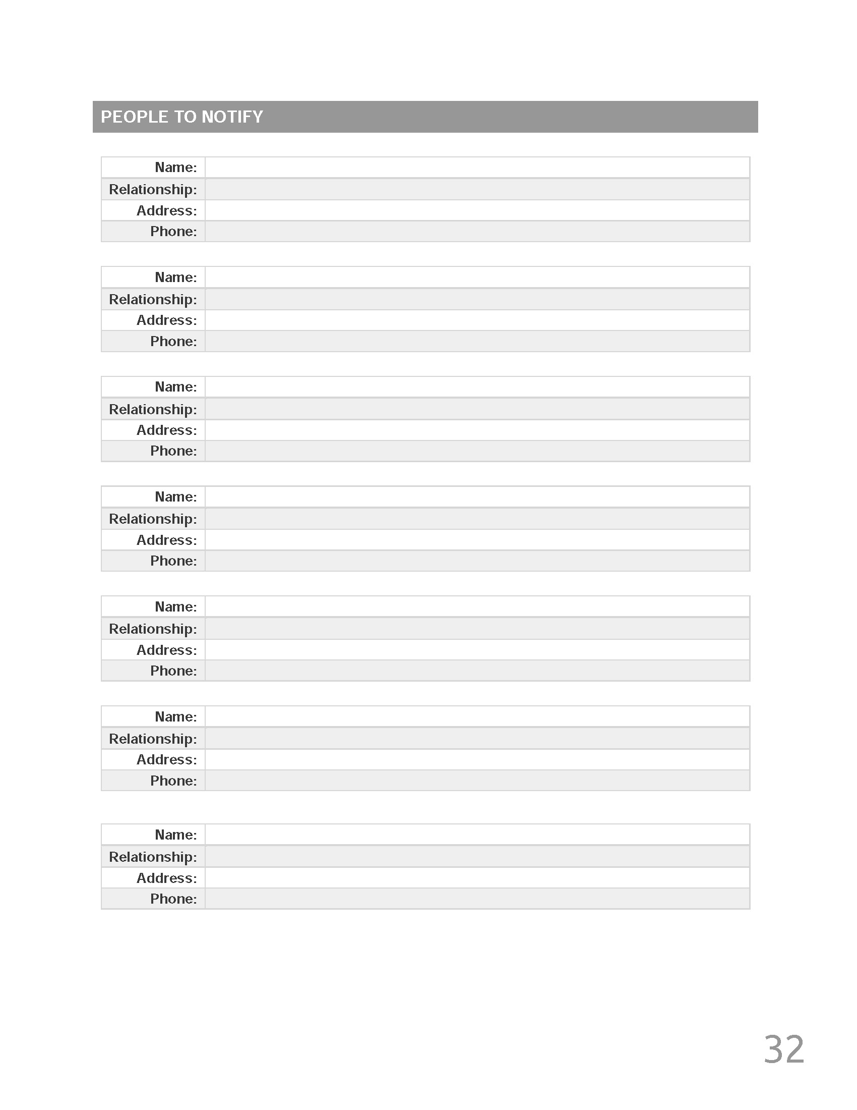

Slide 23
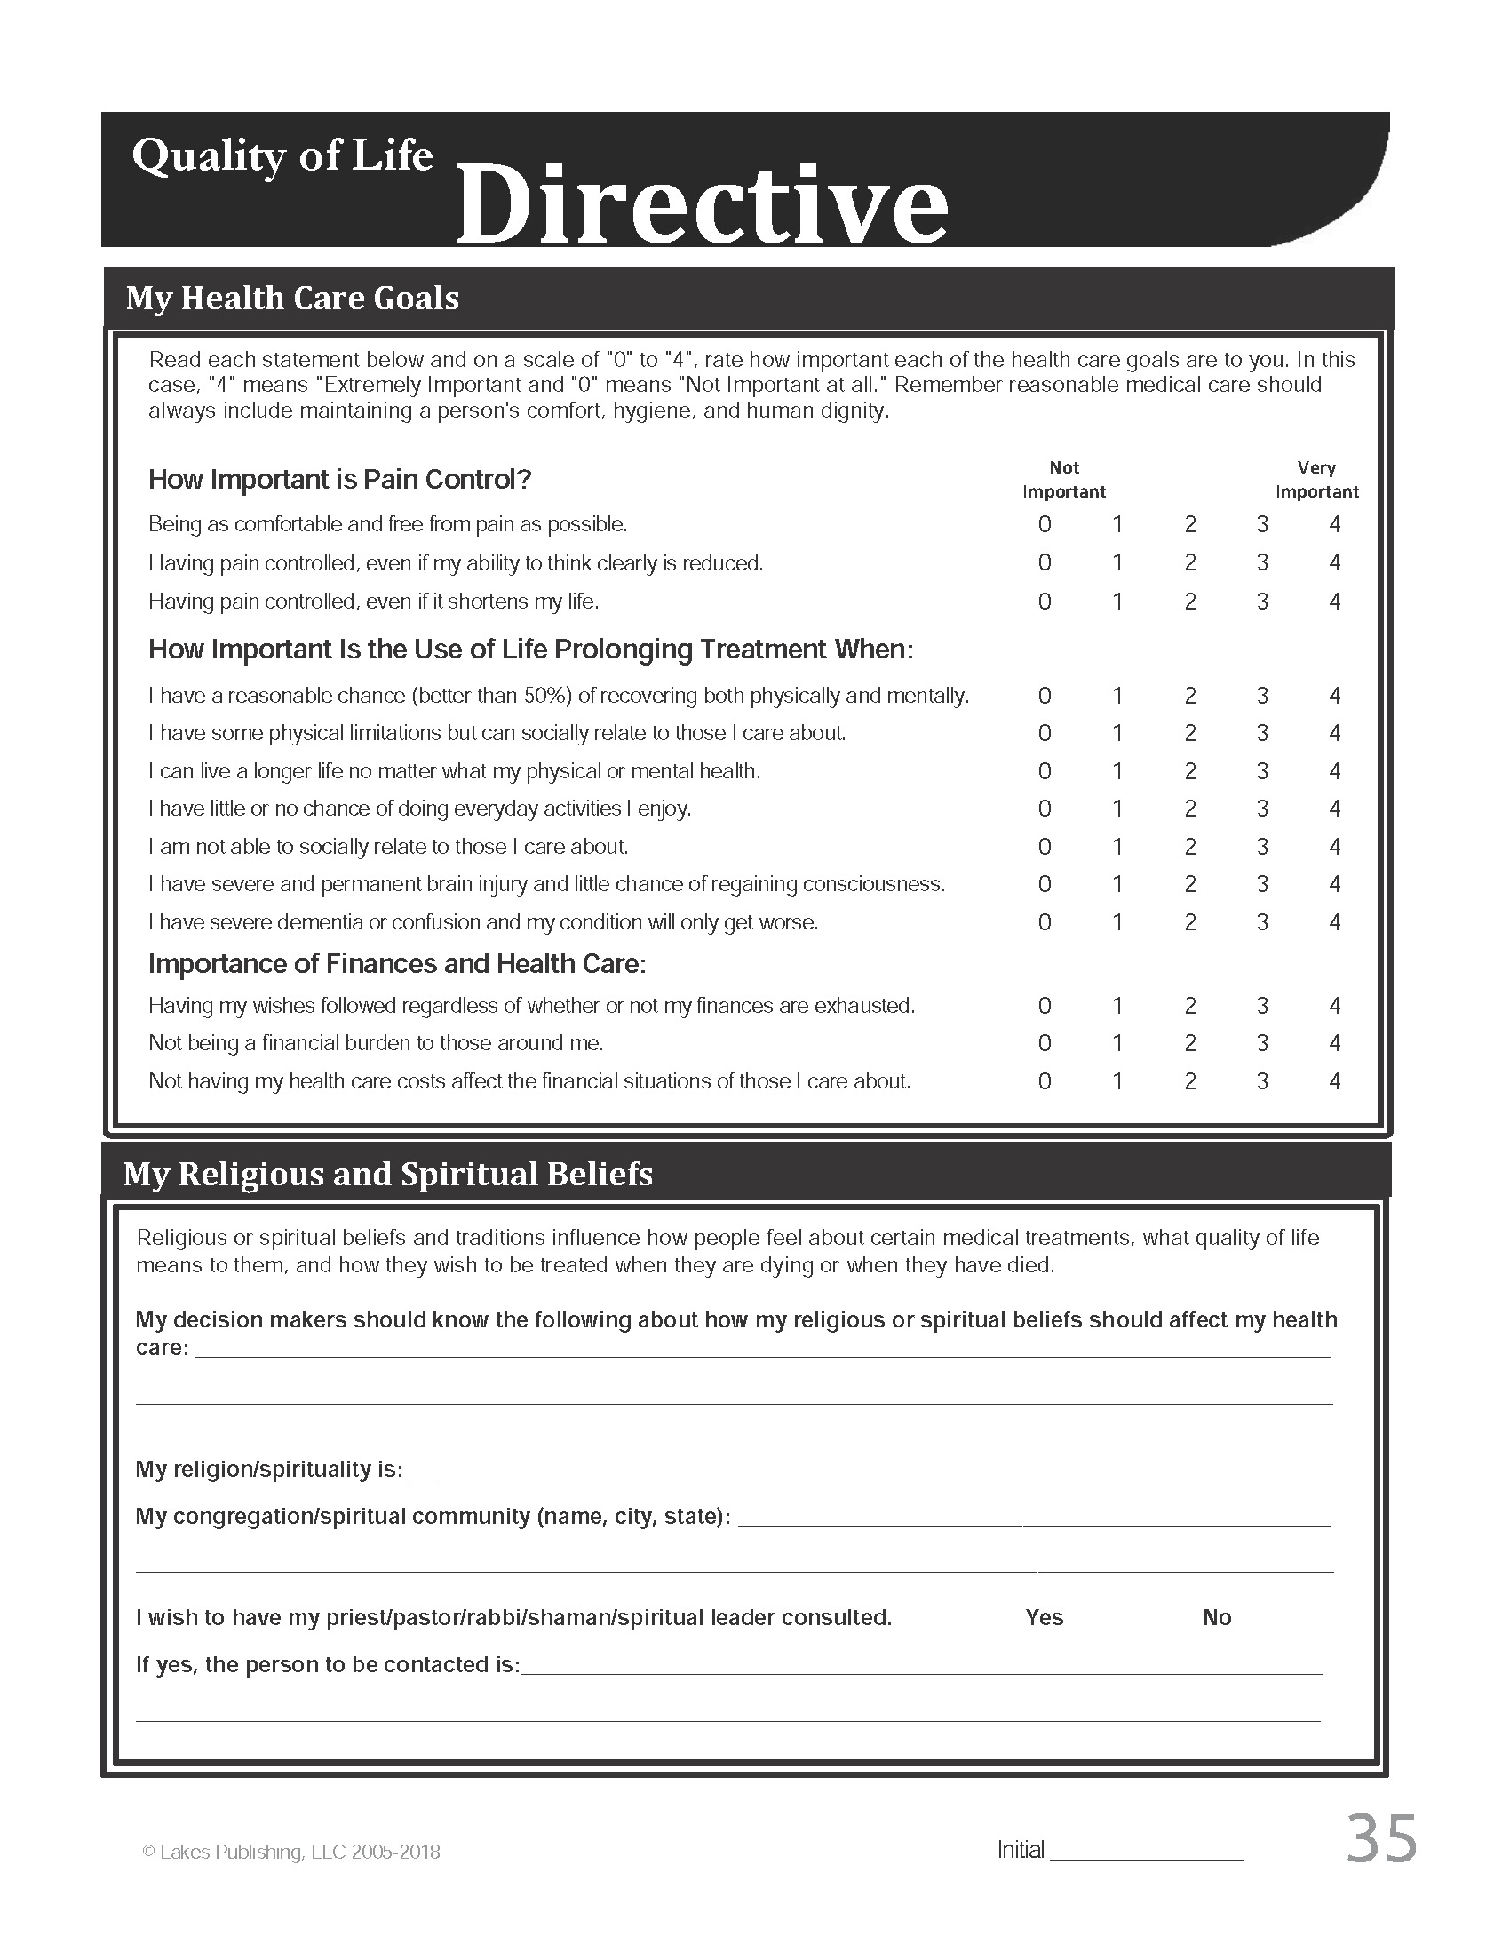

Slide 24
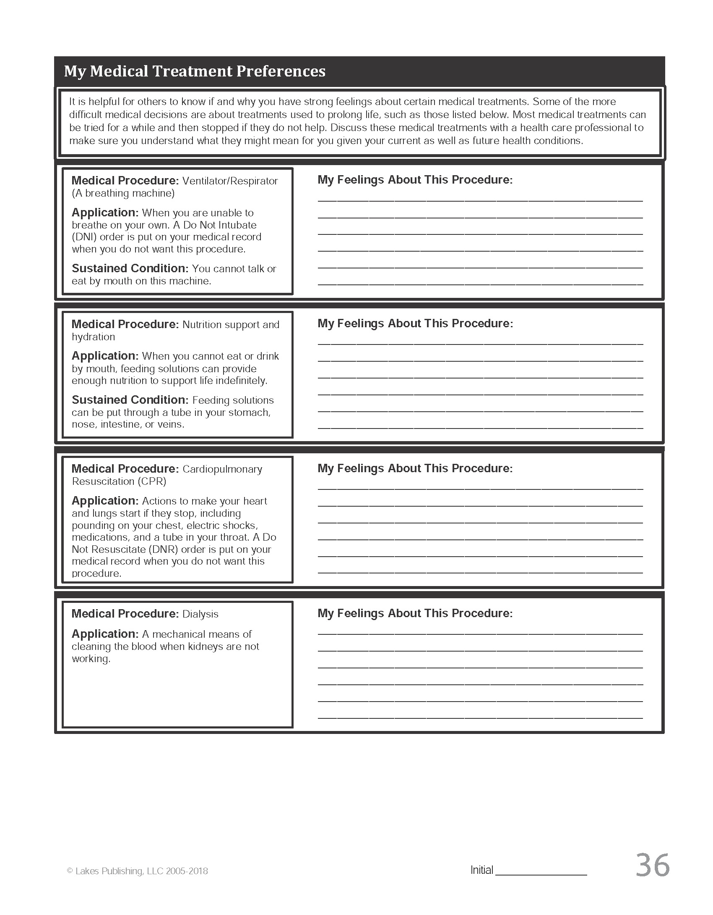

Slide 25
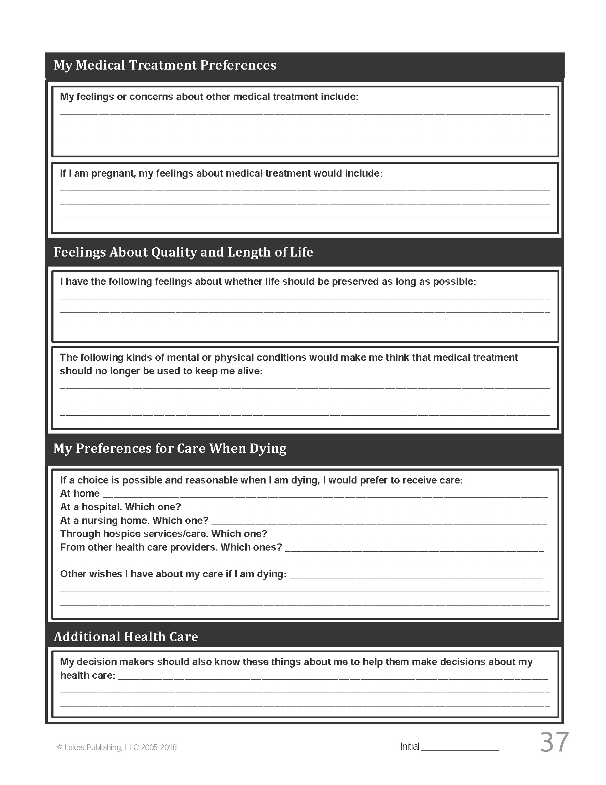

Slide 26
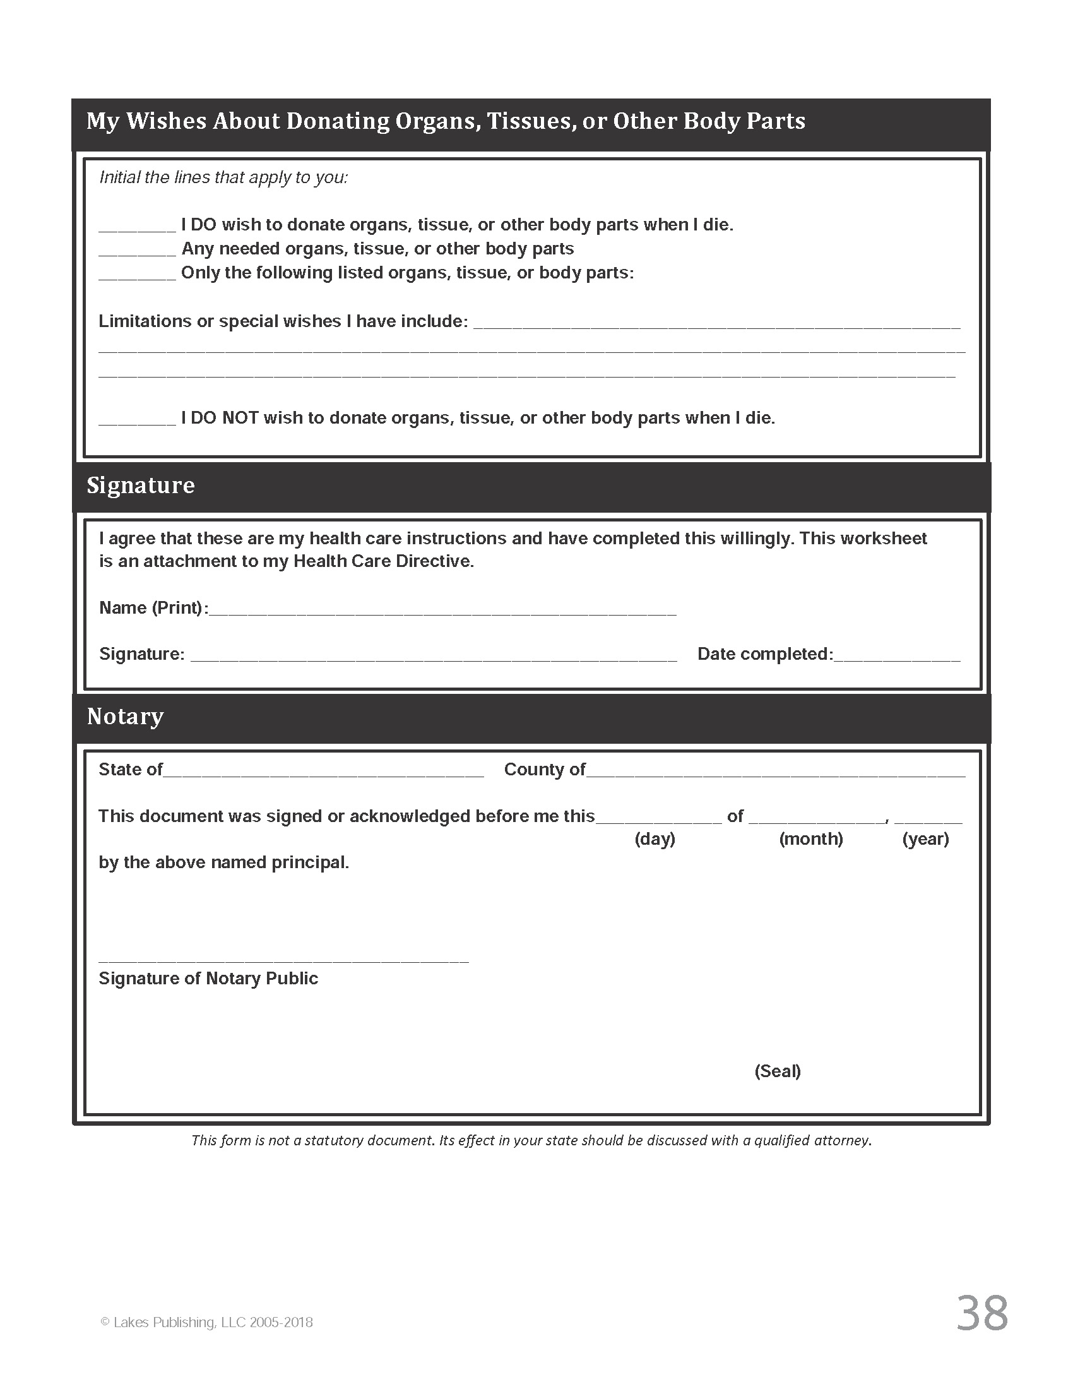

Slide 31
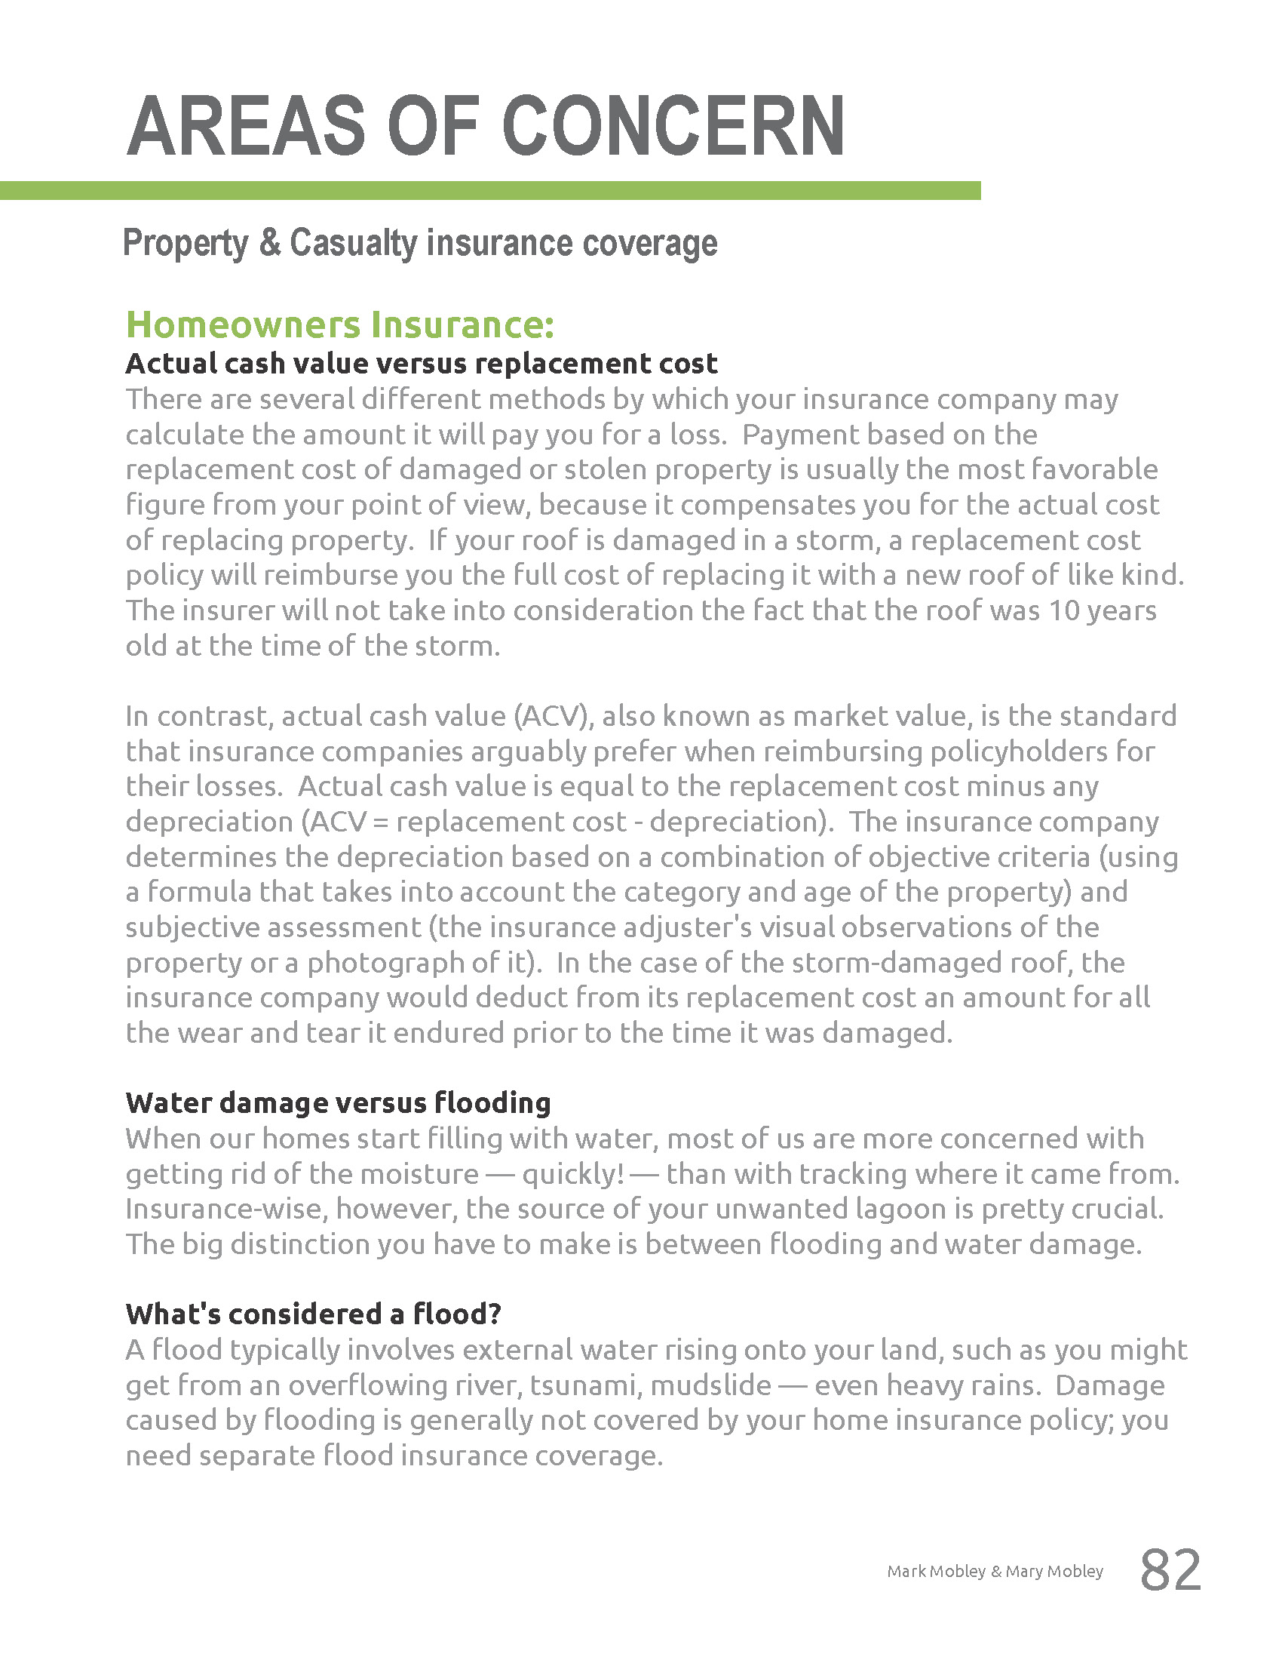

Slide 33
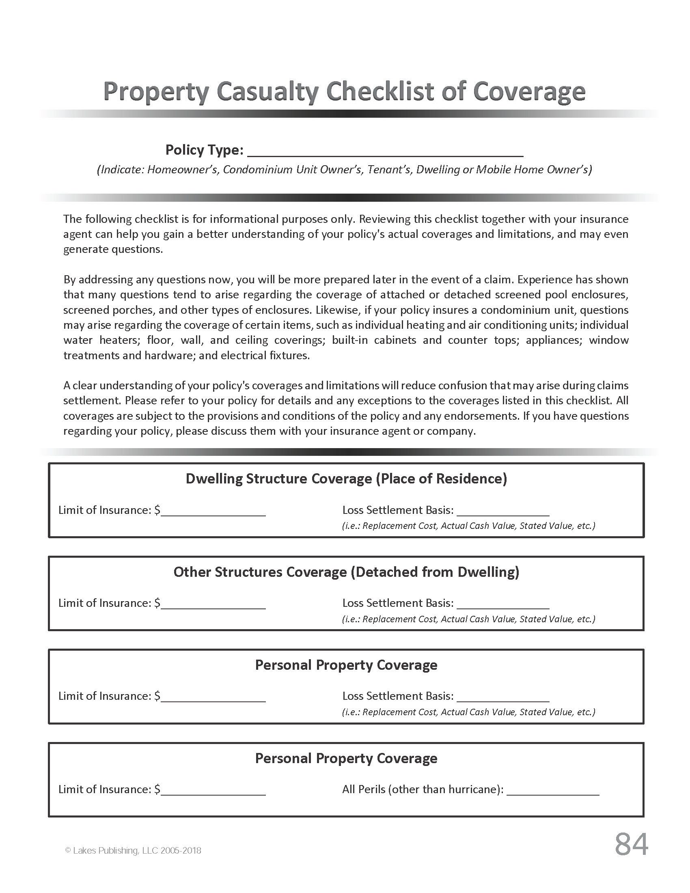

Slide 34
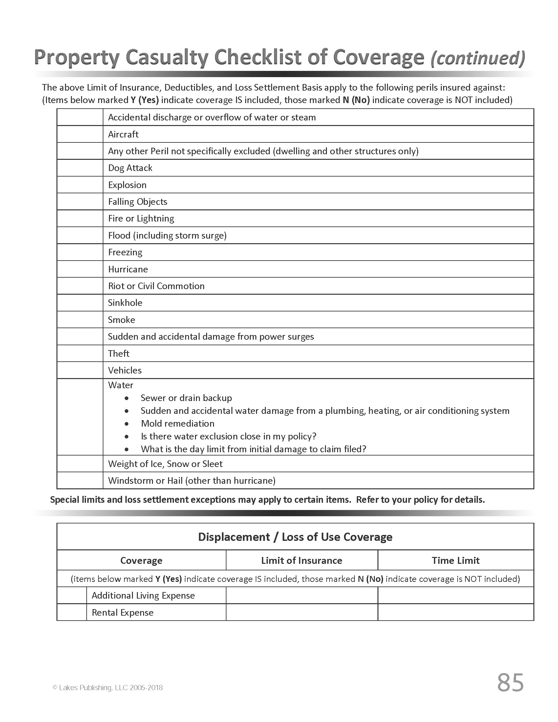

Slide 35
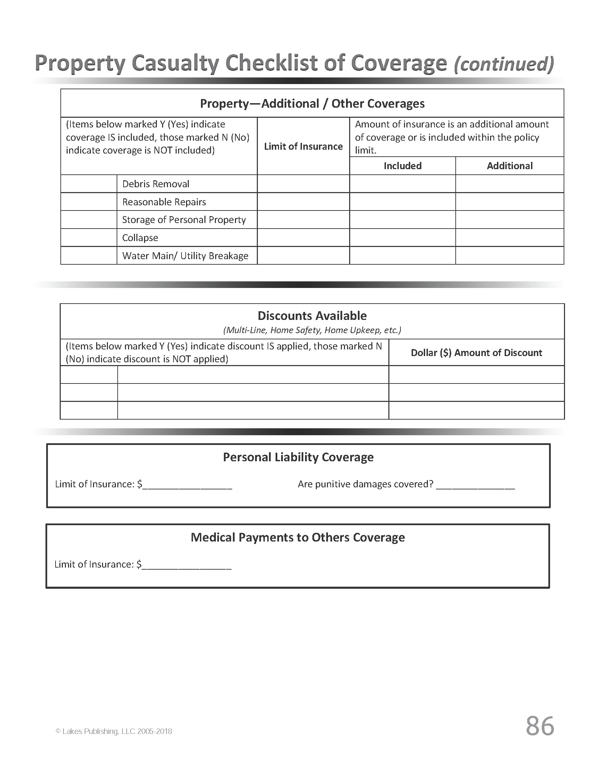

Slide 36
